Slide 1
Types, Variables and Operators
Computer Engineering Department
Java Course
Assoc. Prof. Dr. Ahmet Sayar
Kocaeli University – Fall 2019

Slide 2
Types
Kinds of values that can be stored and manipulated
boolean: Truth value (true or false).
int: Integer (0, 1, -47).
double: Real number (3.14, 1.0, -2.1).
String: Text (“hello”, “example”).

Slide 3
Variables
Named location that stores a value of one particular type
Form:
TYPE NAME;
Example:
String foo;
int x;
A variable must be declared before it is used.

Slide 4
Java Identifiers
An identifier is a name, such as the name of a variable.
Türkish characters are ok
Identifiers may contain only
Letters
Not beginning with digit
digits (0 through 9)
Used only with with letters
the underscore character (_)
and the currency sign symbols ($, £, €)
but the first character cannot be a digit.
Notes:
Türkçe karakterler de kabul eder

Slide 5
Example identifiers: Check their correctness
int k!34;
int 2dfg;
int test1;
int test23we;
int df_;
int sd$;
int @kl;
int $fg;
int k.t;
int k-t;
int şşt;
int $;
int a ei;

Slide 6
Java Identifiers, cont.
Identifiers may not contain any spaces, dots (.), asterisks (*), or other characters:
7-11 netscape.com util.* (not allowed)
Identifiers can be arbitrarily long.
Since Java is case sensitive, stuff, Stuff, and STUFF are different identifiers.

Slide 7
Keywords or Reserved Words
Words such as if are called keywords or reserved words and have special, predefined meanings.
Keywords cannot be used as identifiers.
Other keywords: int, public, class

Slide 8
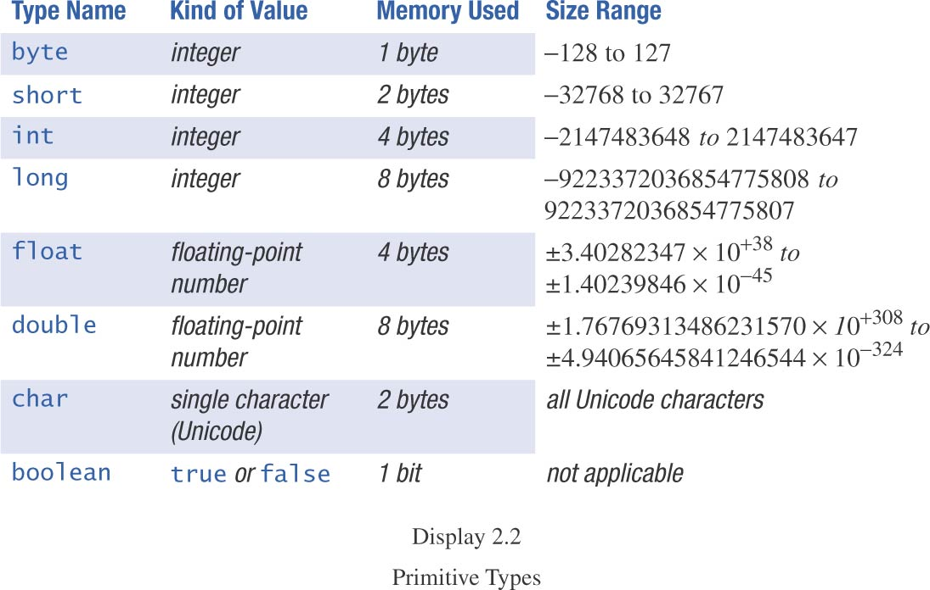
Primitive Types

Slide 9
Assignment
An assignment statement is used to assign a value to a variable.
answer = 42;
Use ‘=‘ to give variables a value.
Example:
String foo;
foo = “IAP 6.092”;
Can be combined with variable declaration
String foo = “IAP 6.092”;
int numberOfBaskets, eggsPerBasket;
int numberOfBaskets=5, eggsPerBasket;

Slide 10
Operators
Symbols that perform simple computations
Assignment: =
Addition: +
Subtraction: -
Multiplication: *
Division: /
Mod: %

Slide 11
Order of Operations - precedence
Follows standard math rules:
Parentheses
Multiplication and division
Addition and subtraction
double x = 3 / 2 + 1;
System.out.println(‘’x = ’’+x);
double y = 3 / (2 + 1);
System.out.println(‘’y = ’’+y);
Notes:
// x = 2.0
// y = 1.0

Slide 12
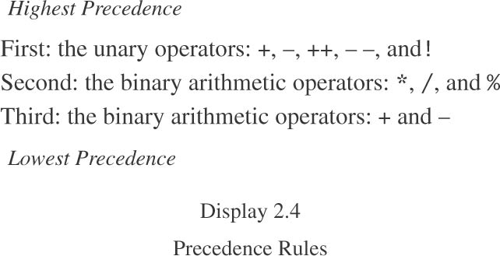
Order of Operations – Cont.

Slide 13
Order of Operations – Cont.
The binary arithmetic operators *, /, and %, have lower precedence than the unary operators ++, --, and !, but have higher precedence than the binary arithmetic operators + and -.
When binary operators have equal precedence, the operator on the left acts before the operator(s) on the right.

Slide 14
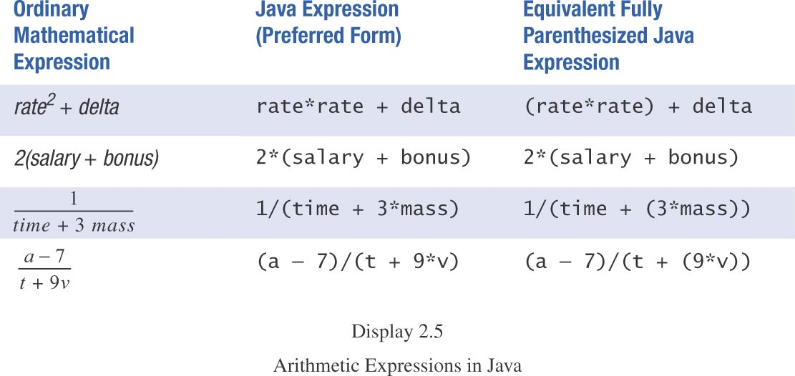
Sample Expressions

Slide 15
Increment (and Decrement) Operators
Used to increase (or decrease) the value of a variable by 1
Easy to use, important to recognize
The increment operator
count++ or ++count
The decrement operator
count-- or --count

Slide 16
Increment (and Decrement) Operators
Equivalent operations
count++;
++count;
count = count + 1;
count--;
--count;
count = count - 1;

Slide 17
Examples
int k=0, y=0, x;
x = ++k-y;
System.out.println("x's value : "+x);
int k=0, y=0, x;
x = k++-y;
System.out.println("x's value : "+x);
Notes:
x’s value: 1
x's value : 0

Slide 18
Increment (and Decrement) Operators in Expressions
after executing
int m = 4;
int result = 3 * (++m)
result has a value of 15 and m has a value of 5
after executing
int m = 4;
int result = 3 * (m++)
result has a value of 12 and m has a value of 5

Slide 19
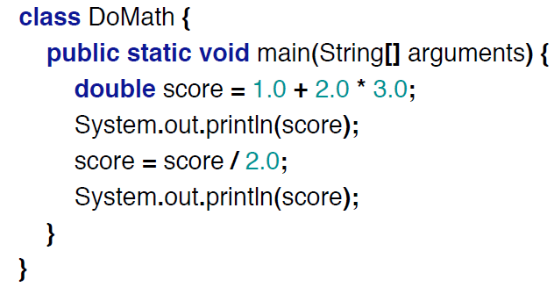
Sample code: operators and assignments
Notes:
7.0
3.5

Slide 20
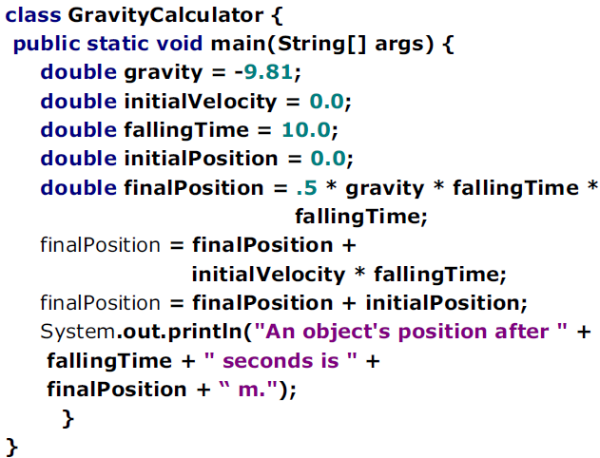

Slide 21
Division
Division (“/”) operates differently on integers and on doubles!
Example:
double a = 5.0/2.0; // a = 2.5
int b = 4/2; // b = 2
int c = 5/2; // c = 2
double d = 5/2; // d = 2.0

Slide 22
Conversion by casting
int a = 2; // a = 2
double a = 2; // a = 2.0 (Implicit)
int a = 18.7; // ERROR
int a = (int)18.7; // a = 18
double a = 2/3; // a = 0.0
double a = (double)2/3; // a = 0.6666…

Slide 23
Conversion by casting - Cont
double z = 3.0/2.0;
System.out.println("===== "+z);
double t = 3/2;
System.out.println("===== "+t);
double m = (double)3/2;
System.out.println("===== "+m);
Notes:
1.5
1.0
1.5

Slide 24
Casting

Slide 25
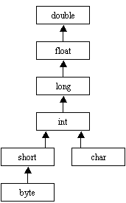
Data Types and Their Relations in a Tree

Slide 26
Casting example
public class Casting {
public static void main(String[] args){
float a=12.5f;
int i = (int) a;
System.out.println("(int)12.5f==" + i);
float f = i;
System.out.println("float değeri: " + f);
f =f * i;
System.out.println(f+"*" + i + "==" + f);
}
}
(int)12.5f==12
float değeri: 12.0
12.0*12==144.0
Notes:
F in değeri çıktı da 144.0 olcak

Slide 27
Which ones are correct?
float f = 2.34f;
double d = f;
f=d;
d=f;
long a = 15878;
f = 1.1*a;
int a = 78;
long b = a*9876;
byte a = 126;
int b = ++a;
byte a; int b;
a=b;
byte a = 1;
short b = a;
float f = 2.34f;
char c=65;
double d;
char c=65;
d = c*f*1.5;
Notes:
C
IC possible loss of precision
IC possible loss of precision
C
C
IC possible loss of precision
C
C
C

Slide 28
public class Casting_2 {
public static void main(String args[]) {
byte x = 126;
System.out.println( DoIt(x) );
}
static String DoIt(int a) {
return "I've received an int of value "+a;
}
static String DoIt(byte a) {
return "I've received a byte of value "+a;
}
}
Notes:
I've received an int of value 126
I've received a byte of value 126
Iki fonksiyon da aciksa byte cagrilir.
Byte ve long olsa en yakını mı çağırır? bak

Slide 29
public class Casting_3 {
public static void main(String args[]) {
char x = 'A';
System.out.println( DoIt(x) );
}
static String DoIt(int a) {
return "I've received an int of value "+a;
}
static String DoIt(byte a) {
return "I've received a byte of value "+a;
}
}
Notes:
I've received an int of value 65
Hata
OZET KURAL:
soldaki daha kapsamli olunca (agacta daha yukarda ise) sorun yok
sagdaki daha kapsamli ise (agacta daha asagida ise) cast et

